Slide 1
Animal Recognition System
Using Keras and TensorFlow
Zixuan Yu/Chung-Yang Li

Slide 2
Introduction
In current circumstance, although most of zoos have indicators for animals, yet sometimes we found that they look different from the signs. Our system using machine learning and TensorFlow, can improve the accuracy to recognize the different animal for people.

Slide 3
Dataset
The dataset is more than 1000 images which are classified as cat, dog, monkey, bird, lion and horse. It is downloaded from ImageNet, google image, and pexels.com.

Slide 4
Approach
Three
Convolution layer

Slide 6
Evaluation
Cross Entropy
VS
Hinge
ADAM
VS
Stochastic Gradient Descent
RELU
VS
SELU
Iteration:250
VS
Iteration:1250

Slide 7
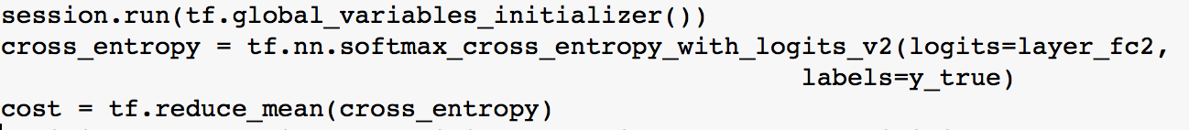
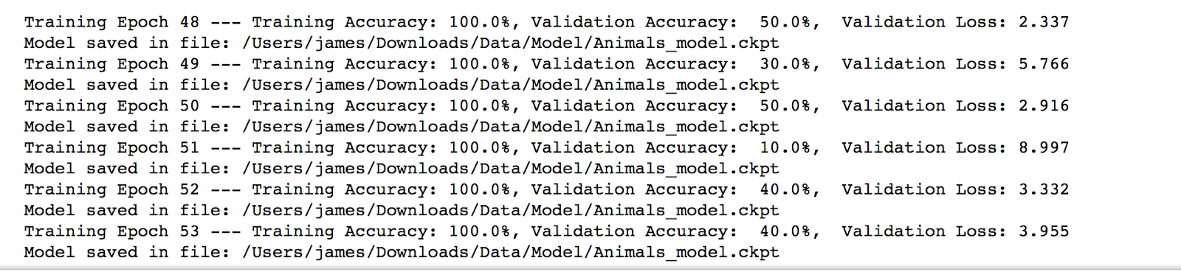
Cost Function—Cross Entropy

Slide 8
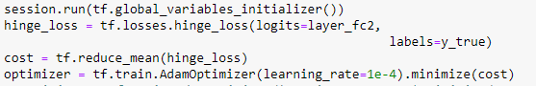
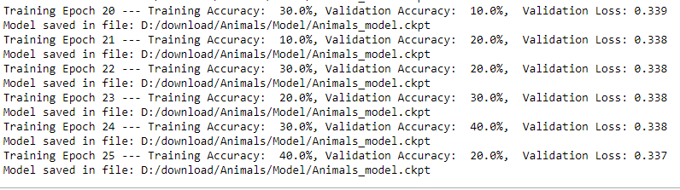
Cost Function—Hinge

Slide 9

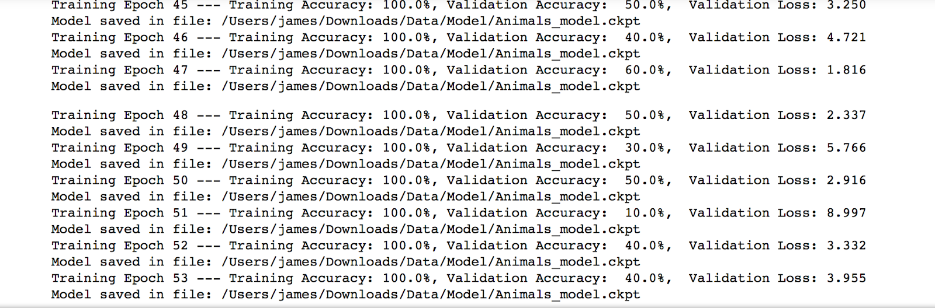
Gradient estimation -- ADAM

Slide 10

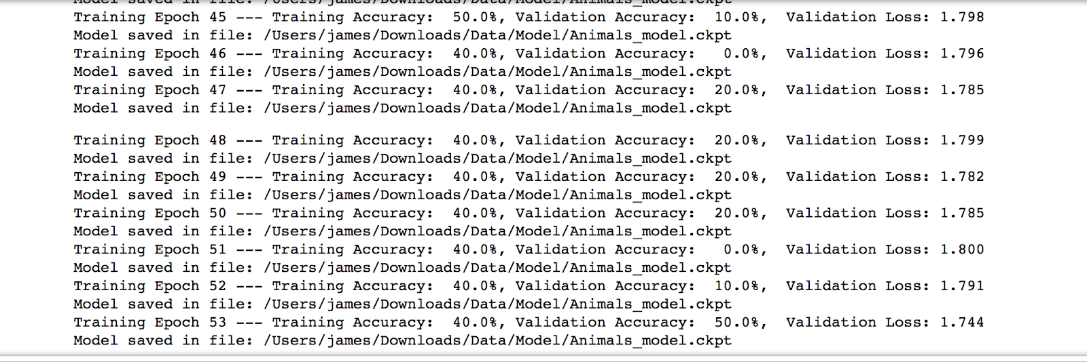
Gradient estimation -- Stochastic Gradient Descent

Slide 11
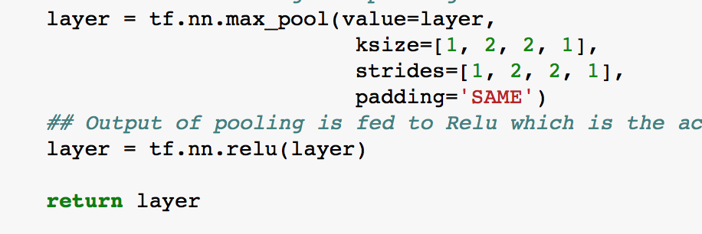
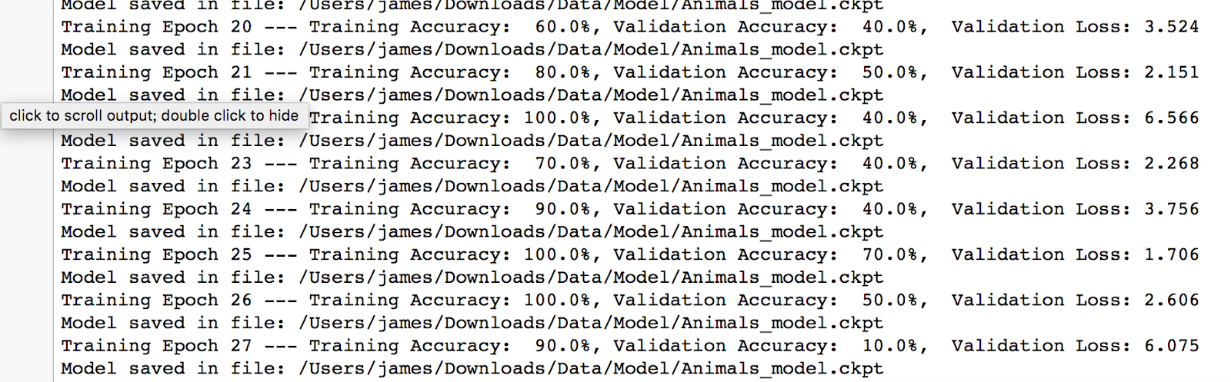
Activation Function--RELU

Slide 12
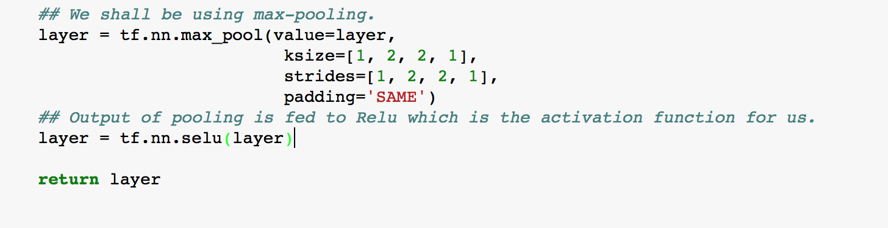
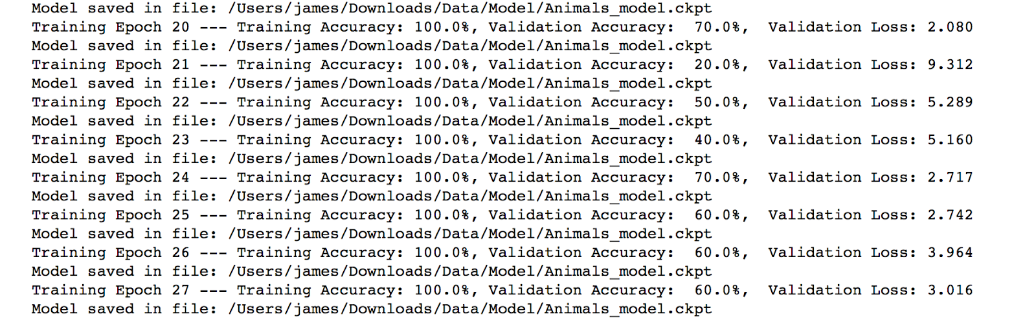
Activation Function--SELU

Slide 13
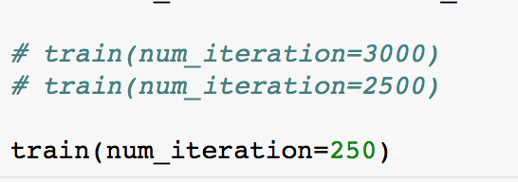
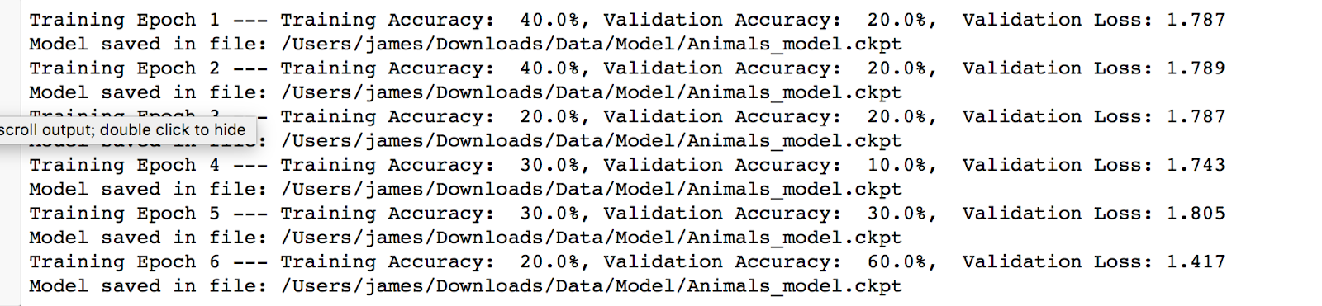
Iteration -- 250

Slide 14
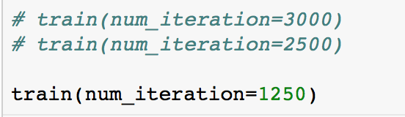
Iteration -- 1250

Slide 15
Conclusion
Cross Entropy
VS
Hinge
ADAM
VS
Stochastic Gradient Descent
RELU
VS
SELU
Iteration:250
VS
Iteration:1250
RED MEANS BETTER

Slide 16
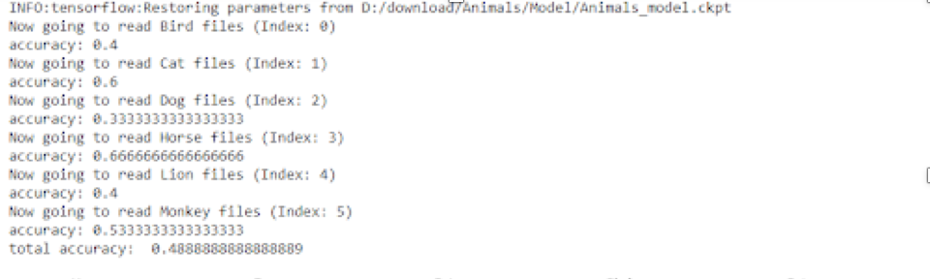
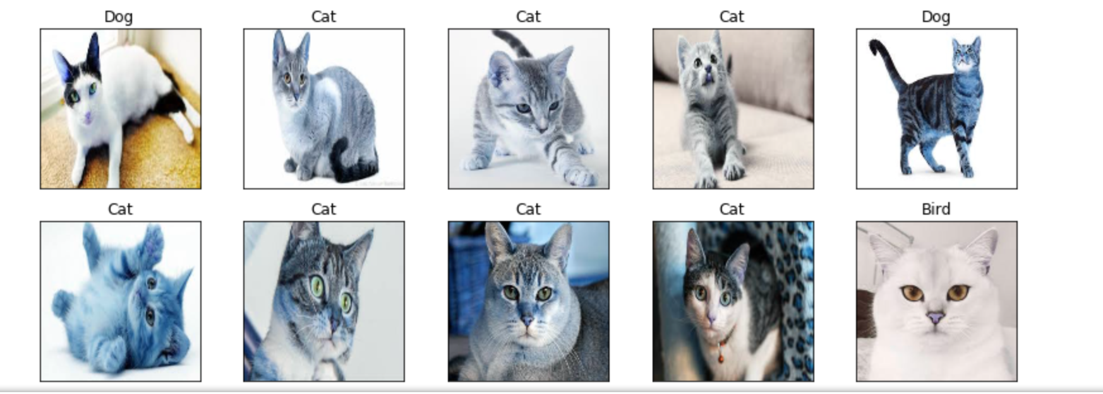
Result

Slide 17
Future Scope
Because of time limitation, we can not find enough picture to train our model( only use 100 pictures each animal). If we use thousands of pictures to train, we can get a better accuracy.

Slide 18
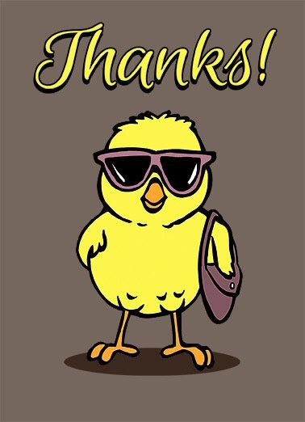
Thank you

